Slide 1


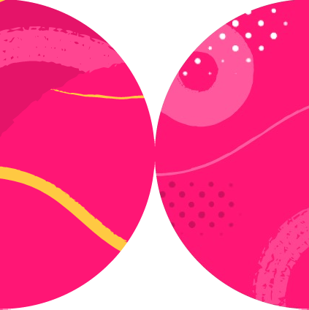

Playwright
Integration with CI/CD - GitHub Actions

Slide 3

Introduction
Overview
Setting up GitHub Actions
On push/pull_request
Create a Repo and Push to GitHuB
YAML Configuration for Playwright Tests
Understanding the Workflow
Create tests in the local repo
Push code to GitHub
Opening the Workflows​
Viewing Test Logs​
HTML Report​
Downloading the HTML Report​
Viewing the HTML Report​
Summary
Overview

Slide 4
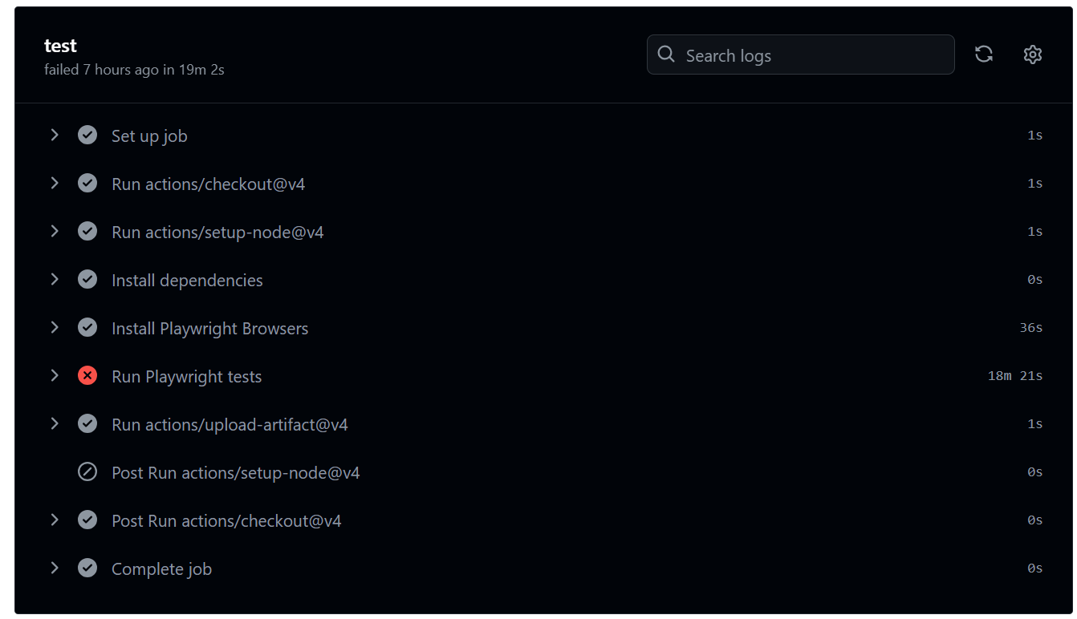

Slide 5
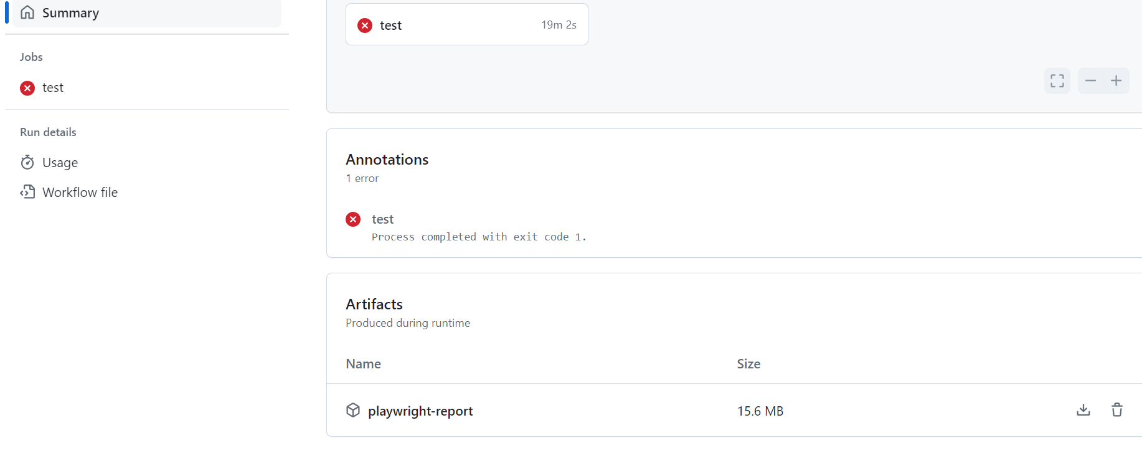

Slide 6
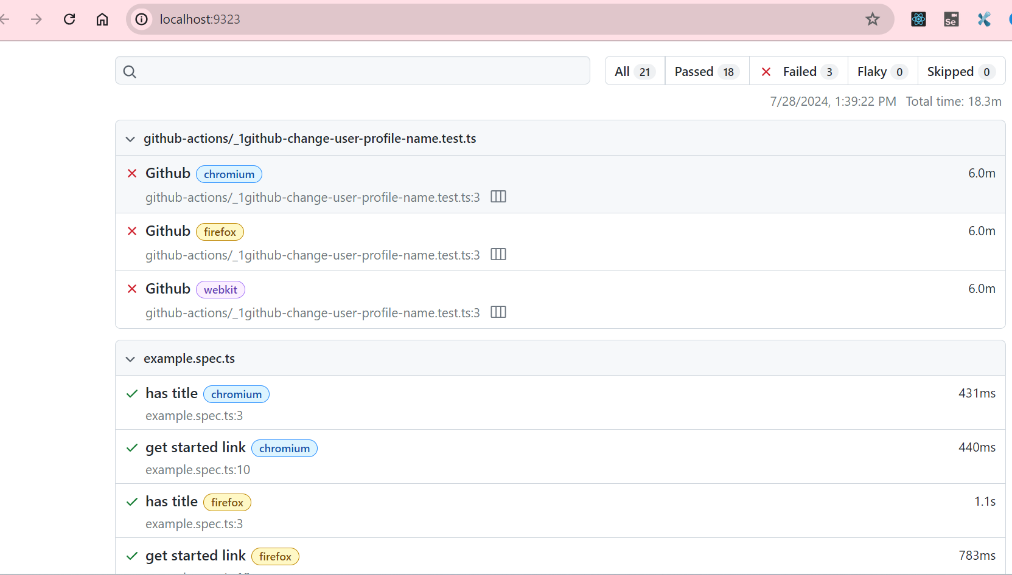

Slide 7
Benefits of Automation:-
•Increased Efficiency
•Faster Feedback Loop
•Consistency
Summary

Slide 8
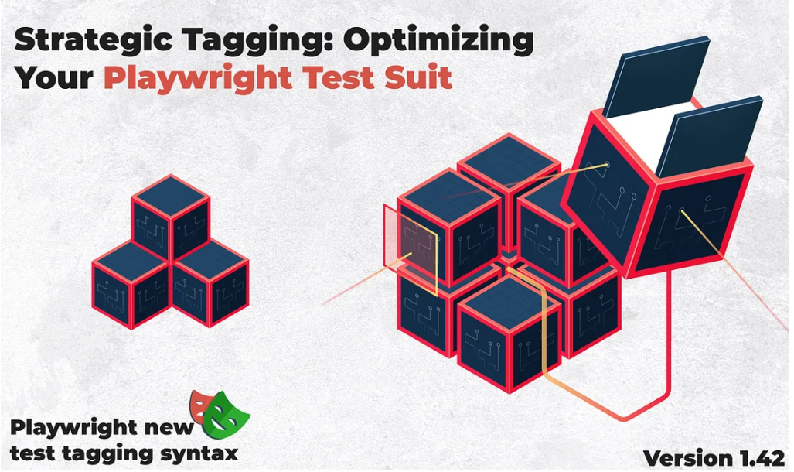

Slide 9
Introduction
Update to the latest version of Playwright
Old Playwright Syntax
How to run tests by tags and using “grep”?
New Playwright Syntax
Advantages of using @tag in test management
Summary
Overview

Slide 10
One or more tags can be attached to a test
Used to organize your test runs
A useful way of filtering your test reports
Each tag is a string.
Playwright automatically tags test results with the browser type (i.e. chromium, firefox, webkit)
Additional tags are up to you
Common ways to use tags:
Browser type (automatic)
Test speed
Area of functionality
Summary

Slide 11
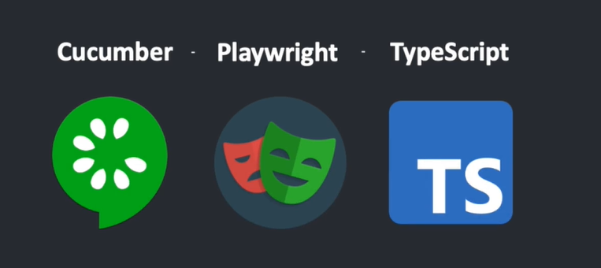

Slide 12
How to Integrate Cucumber With Playwright
Introduction
Create a folder e.g playwright_cucumber
What is Cucumber ?
Set up Cucumber With Playwright
Create feature file
Create a runner file
Script for npm test
First test run
Create Step definition
Summary
Overview

Slide 13
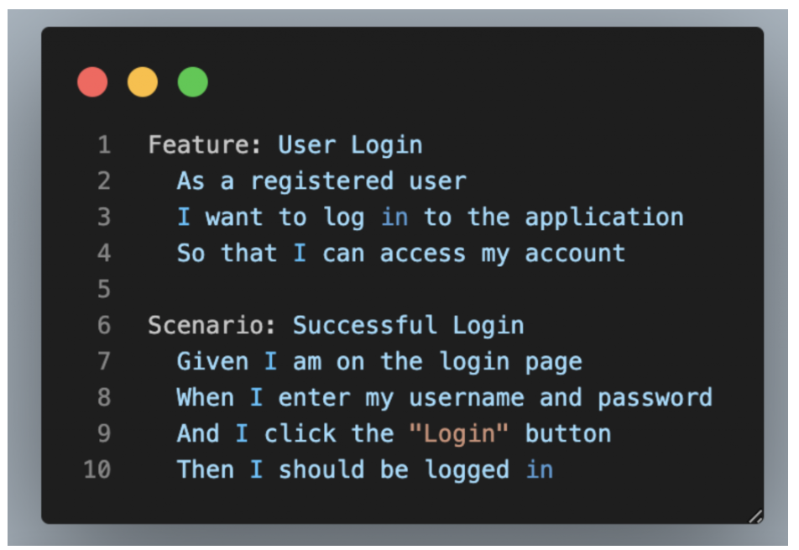

Slide 14
Playwright and Cucumber Automation using TypeScript
Install Playwright
Install Cucumber Plugin
Prepare Project Structure
Create Feature file
Create cucumber.json file
Add script to package.json
Create Step Definitions
Update setting.json file
Summary
Overview

Slide 15
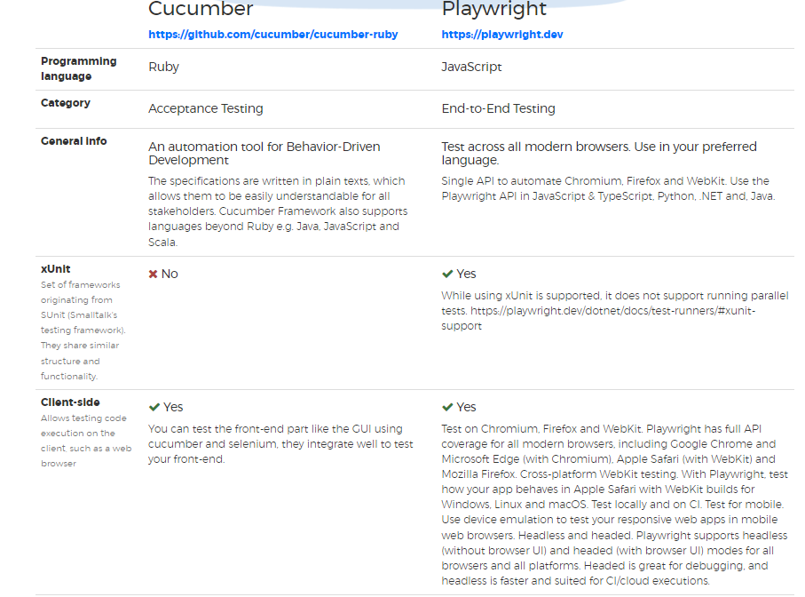
Summary

Slide 16
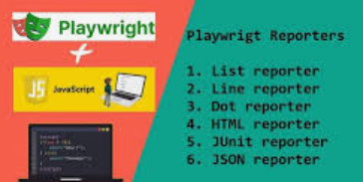

Slide 17
Mastering Playwright Reporting
What is Playwright?
Playwright Parallelism (and Disabling Parallelism)
How to Run Tests on Playwright
Configuring Playwright Reporting
Multiple Reports
Built-In Reporters
1.List Reporter
2.Line Reporter
3.Dot Reporter
4.HTML Reporter
5.JSON Reporter
6.JUnit Reporter
7.GitHub Actions Annotations
Custom Reporters
Allure for Playwright
Overview

Slide 18
Built In and Custom Reporters
In Playwright

Slide 19


Slide 20


Slide 21
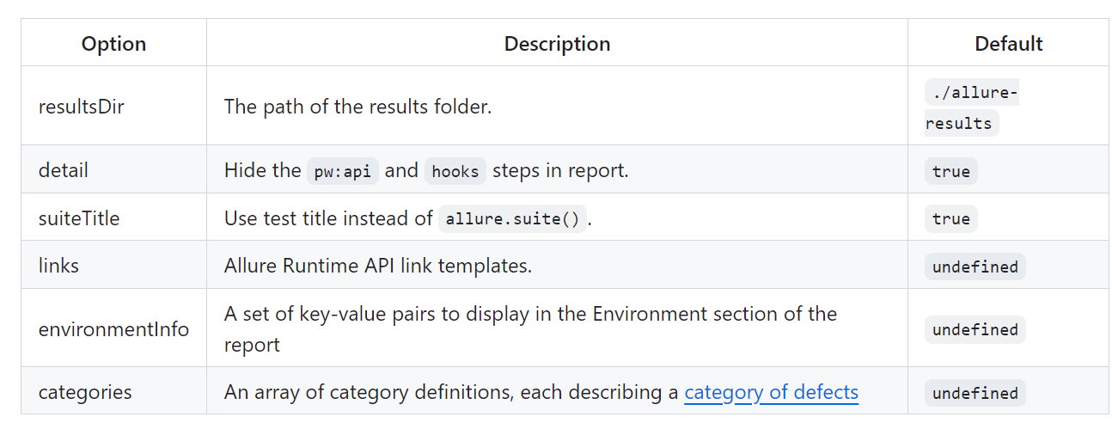
Allure Playwright options
Use the following options to configure Allure Playwright:
https://allurereport.org/docs/playwright-reference/#metadata
https://allurereport.org/docs/playwright-configuration/
.

Slide 22
Generate beautiful HTML reports using Allure Report and your Playwright tests.
Use the provided functions from 'allure-js-commons' to integrate your Playwright tests with Allure.
Note that while standard features require importing the test object from Playwright, the additional features also require importing the functions directly from 'allure-js-commons'
Summary

